Slide 1

Algebra 1
Unit 12, Lesson 6 Estimating for a Population Volume 2, pg. 224

Slide 2


Benchmark
MA.912.DP.1.4
Estimate a population total, mean, or percentage using data from a sample survey; develop a margin of error through the use of simulation.
volume 2, pg. 224

Slide 3
Integrated Mathematical Thinking and Reasoning Standards
MA.K12.MTR.6.1 Assess the reasonableness of solutions.
MA.K12.MTR.7.1 Apply mathematics to real-world contexts.
volume 2, pg. 224

Slide 4

Learning Target
I can use margin of error to estimate a population total, mean, or percentage using data.
volume 2, pg. 224

Slide 5

Warm-Up
volume 2, pg. 225

Slide 6
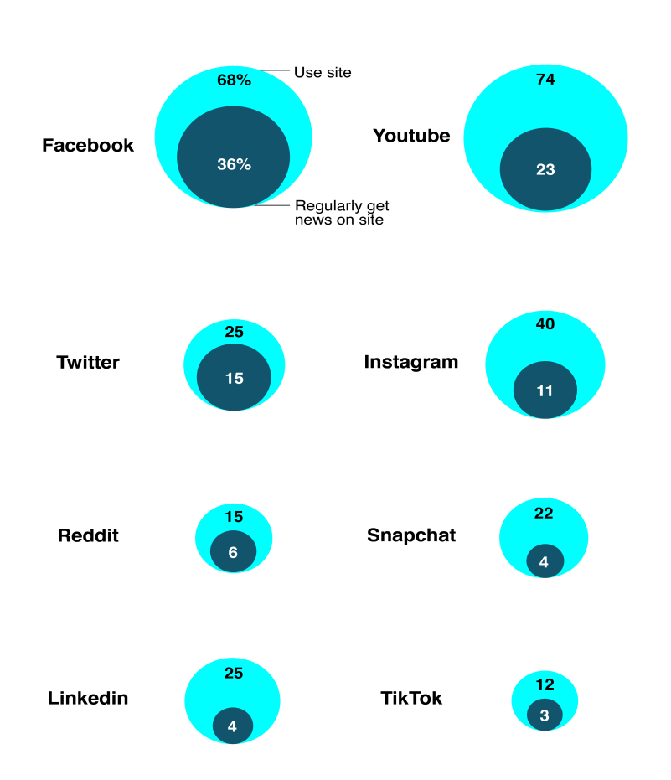
12.6.1 Warm-Up: News Source
The graphic below summarizes data from a 2020 Pew Research Study. It shows the percent of U.S. adults who use each site and regularly get news on each site.
What do you notice? What do you wonder?
volume 2, pg. 225

Slide 7

Guided Instruction
volume 2, pg. 225

Slide 8

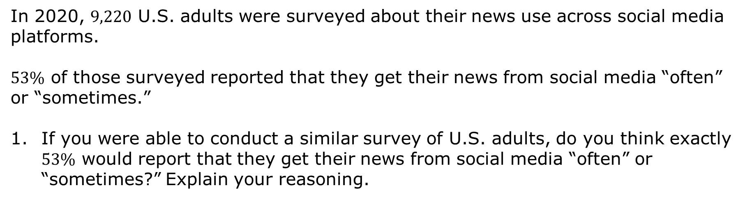
12.6.2 Guided Instruction: Margin of Error
In 2020, $9,220$ U.S. adults were ­surveyed about their news use across social media platforms.
$53\%$ of those surveyed reported that they get their news from social media “often” or “sometimes.”
If you were able to conduct a similar survey of U.S. adults, do you think exactly $53\%$ would report that they get their news from social media “often” or “sometimes?” Explain your reasoning.
volume 2, pg. 225

Slide 9
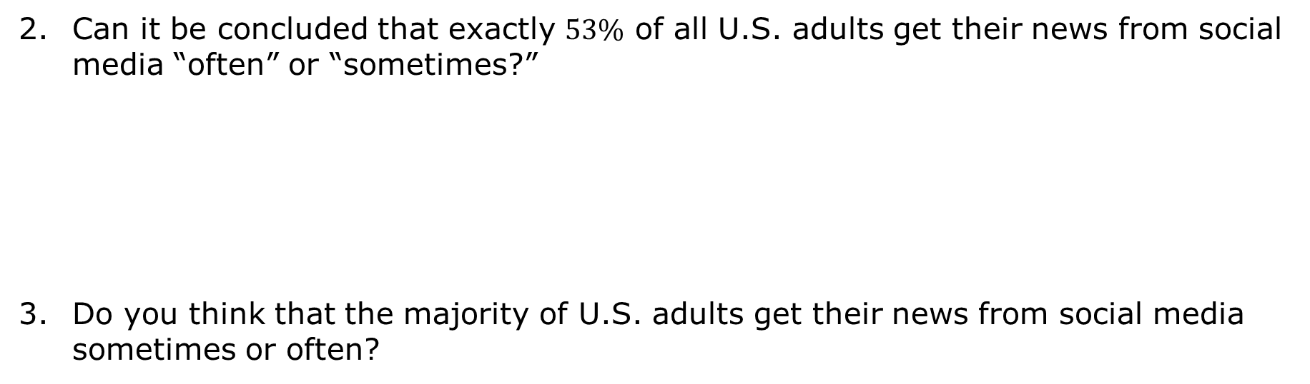
Can it be concluded that exactly $53\%$ of all U.S. adults get their news from social media “often” or “sometimes?”
Do you think that the majority of U.S. adults get their news from social media sometimes or often?
volume 2, pg. 225

Slide 10
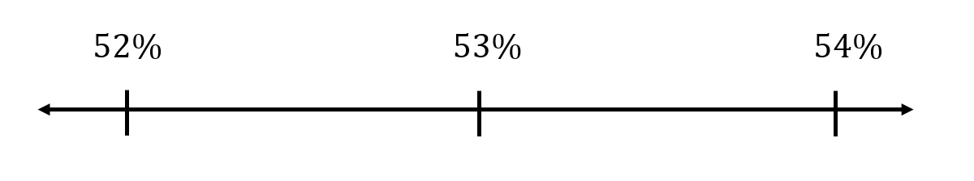
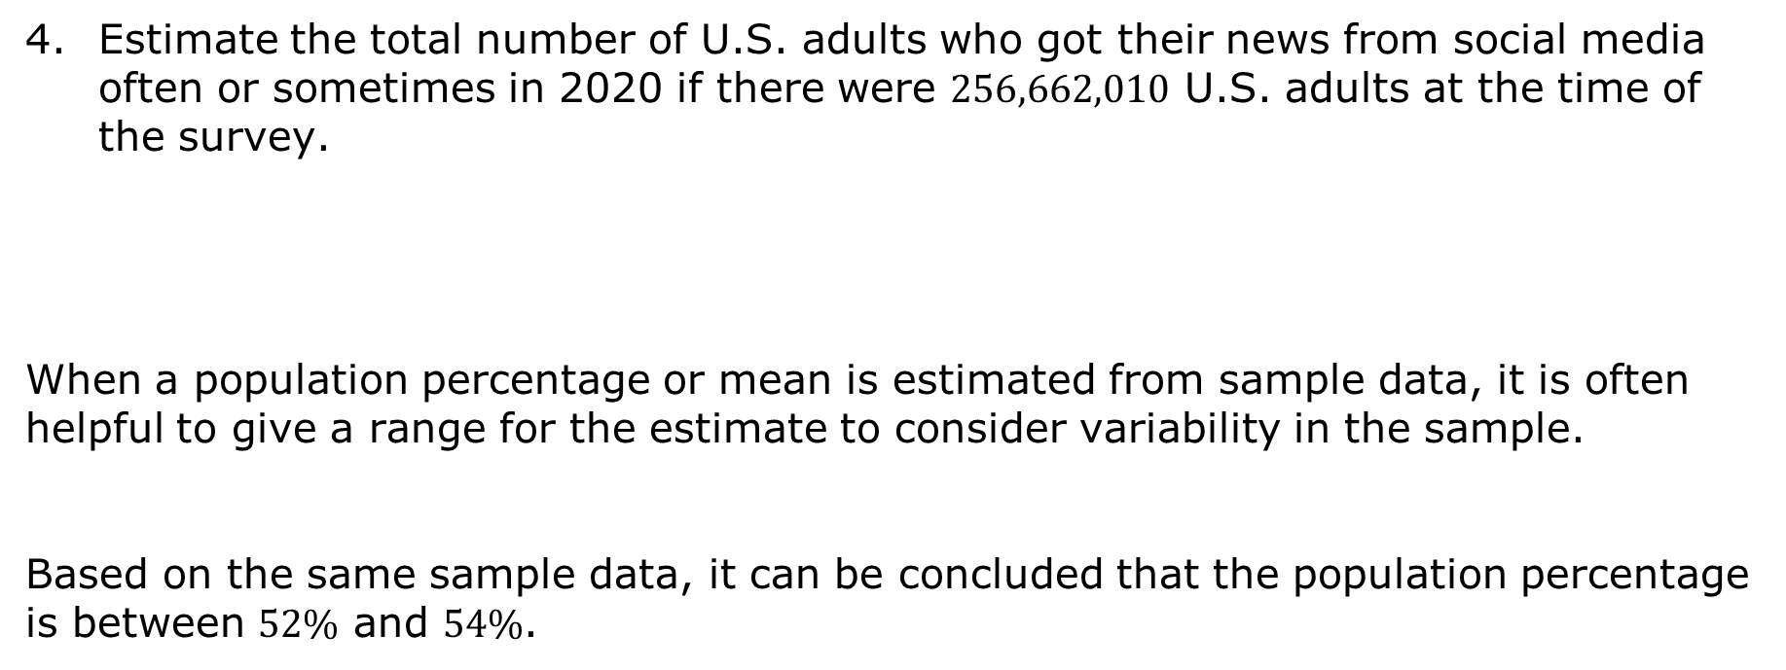
Estimate the total number of U.S. adults who got their news from social media often or sometimes in 2020 if there were $256,662,010$ U.S. adults at the time of the survey.
When a population percentage or mean is estimated from sample data, it is often helpful to give a range for the estimate to consider variability in the sample.
Based on the same sample data, it can be concluded that the population percentage is between $52\%$ and $54\%$.
volume 2, pg. 226

Slide 11
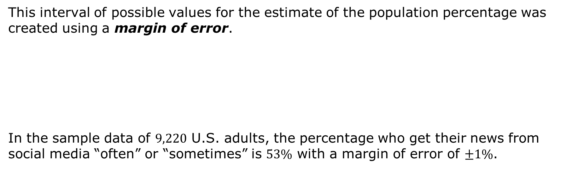
This interval of possible values for the estimate of the population percentage was created using a margin of error.
In the sample data of $9,220$ U.S. adults, the percentage who get their news from social media “often” or “sometimes” is $53\%$ with a margin of error of $±1\%$.
The margin of error quantifies the amount of random sampling error in the results of a survey.
volume 2, pg. 226

Slide 12
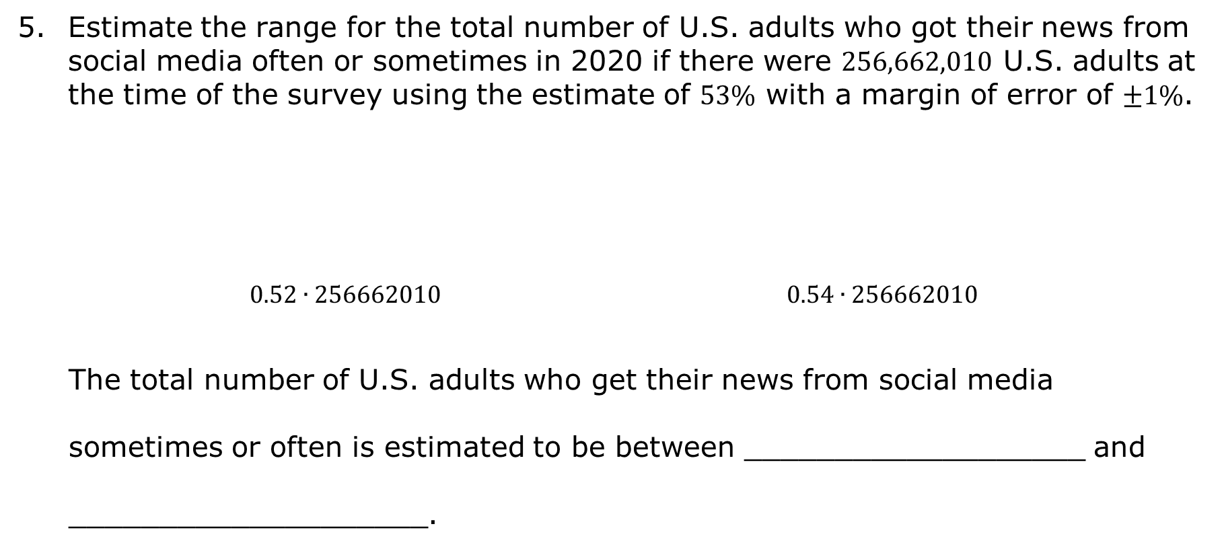
Estimate the range for the total number of U.S. adults who got their news from social media often or sometimes in 2020 if there were $256,662,010$ U.S. adults at the time of the survey using the estimate of $53\%$ with a margin of error of $±1\%$.
$0.52∙256662010$ $0.54∙256662010$
The total number of U.S. adults who get their news from social media sometimes or often is estimated to be between ___________________ and ____________________.
volume 2, pg. 226

Slide 13

Guided Practice
volume 2, pg. 227

Slide 14

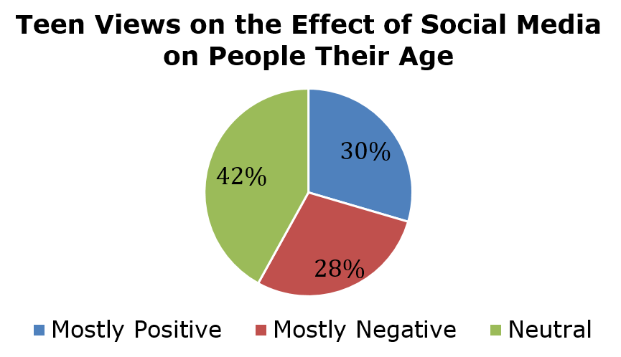
12.6.3 Guided Practice: Estimating for a Population
The results of $741$ teens surveyed in a 2018 Pew Research Study are shown in the circle graph.
volume 2, pg. 227

Slide 15
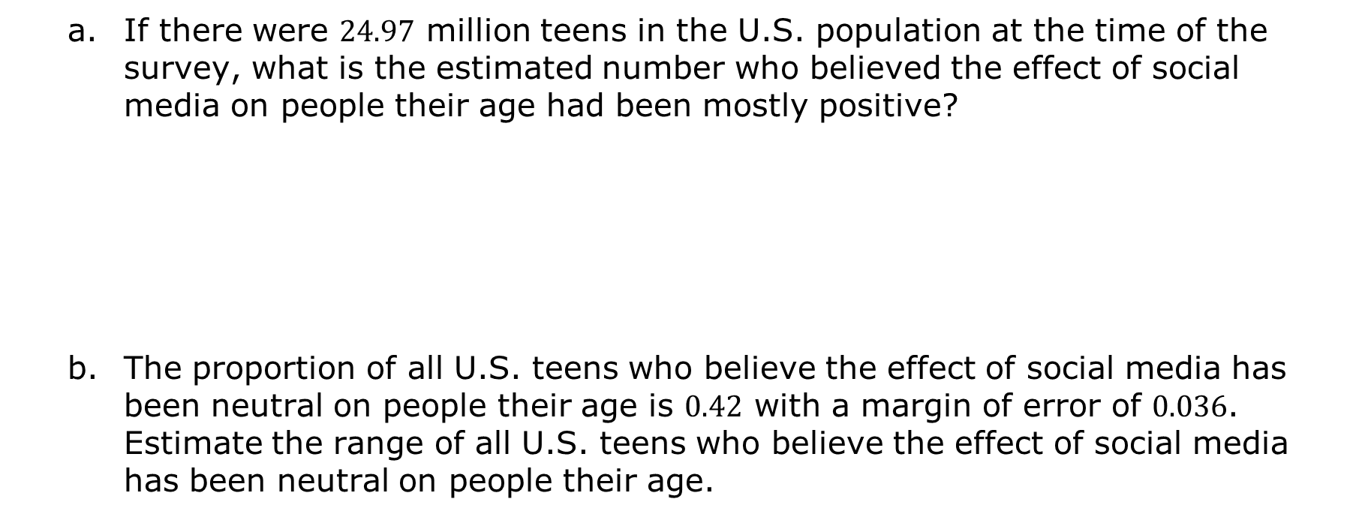
If there were $24.97$ million teens in the U.S. population at the time of the survey, what is the estimated number who believed the effect of social media on people their age had been mostly positive?
The proportion of all U.S. teens who believe the effect of social media has been neutral on people their age is $0.42$ with a margin of error of $0.036$. Estimate the range of all U.S. teens who believe the effect of social media has been neutral on people their age.
volume 2, pg. 227

Slide 16
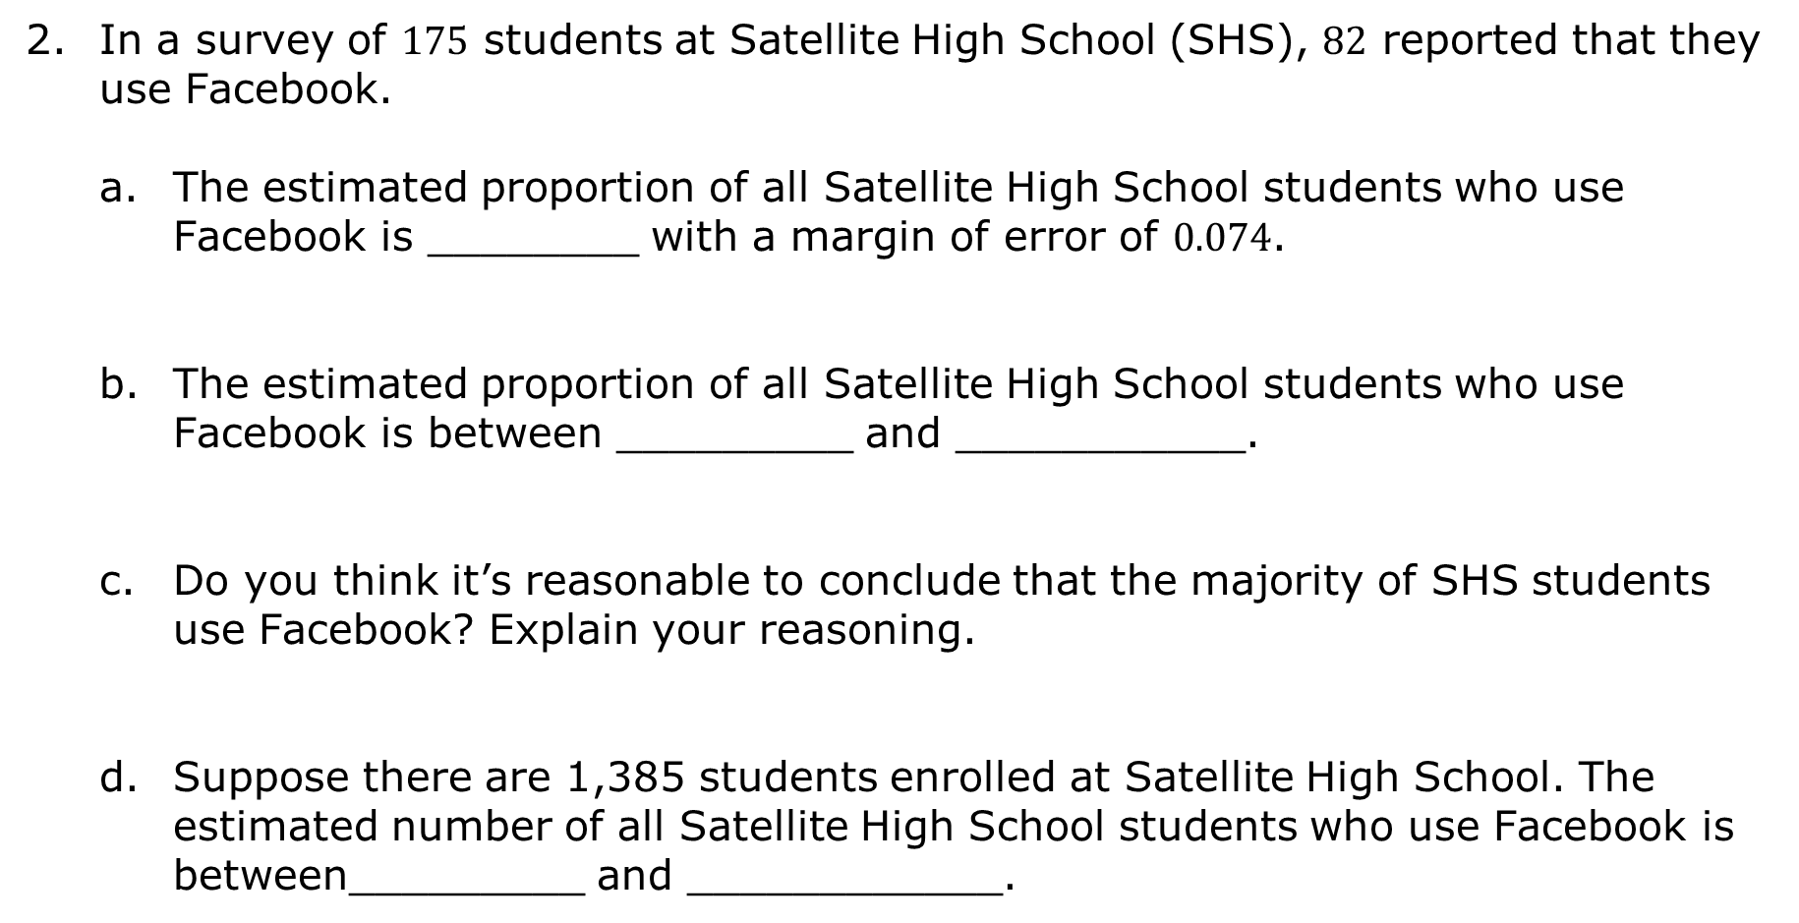
In a survey of $175$ students at Satellite High School (SHS), $82$ reported that they use Facebook.
The estimated proportion of all Satellite High School students who use Facebook is ________ with a margin of error of $0.074$.
The estimated proportion of all Satellite High School students who use Facebook is between _________ and ___________.
Do you think it’s reasonable to conclude that the majority of SHS students use Facebook? Explain your reasoning.
Suppose there are 1,385 students enrolled at Satellite High School. The estimated number of all Satellite High School students who use Facebook is between_________ and ____________.
volume 2, pg. 227

Slide 17
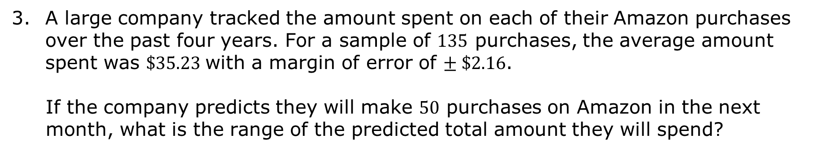
A large company tracked the amount spent on each of their Amazon purchases over the past four years. For a sample of $135$ purchases, the average amount spent was $\$35.23$with a margin of error of $± \$2.16$.
If the company predicts they will make $50$ purchases on Amazon in the next month, what is the range of the predicted total amount they will spend?
volume 2, pg. 228

Slide 18

Your Turn
volume 2, pg. 228

Slide 19
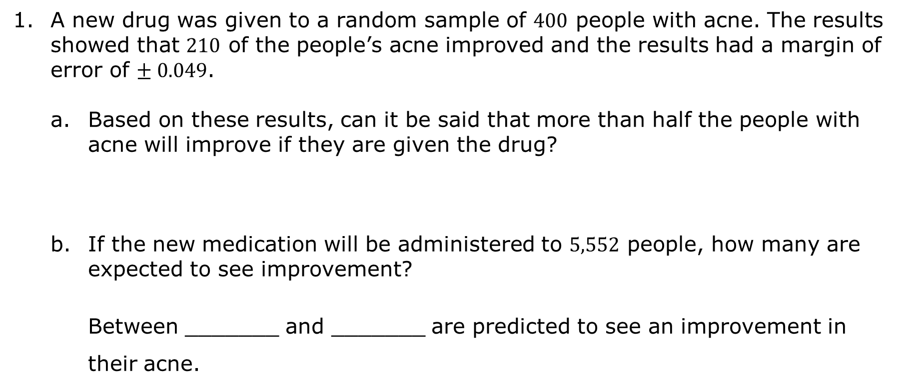
12.6.4 Your Turn!
A new drug was given to a random sample of $400$ people with acne. The results showed that $210$ of the people’s acne improved and the results had a margin of error of $± 0.049$.
Based on these results, can it be said that more than half the people with acne will improve if they are given the drug?
If the new medication will be administered to $5,552$ people, how many are expected to see improvement?
Between _______ and _______ are predicted to see an improvement in their acne.
volume 2, pg. 228

Slide 20
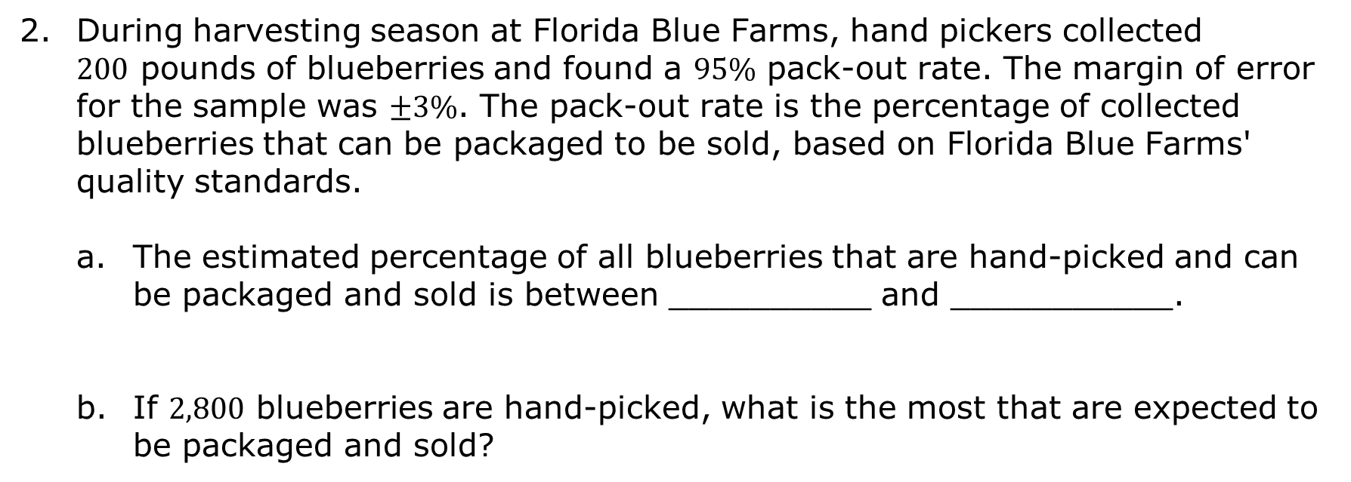
During harvesting season at Florida Blue Farms, hand pickers collected $200$ pounds of blueberries and found a $95\%$ pack-out rate. The margin of error for the sample was $±3\%$. The pack-out rate is the percentage of collected blueberries that can be packaged to be sold, based on Florida Blue Farms' quality standards.
The estimated percentage of all blueberries that are hand-picked and can be packaged and sold is between __________ and ___________.
If $2,800$ blueberries are hand-picked, what is the most that are expected to be packaged and sold?
volume 2, pg. 229

Slide 21
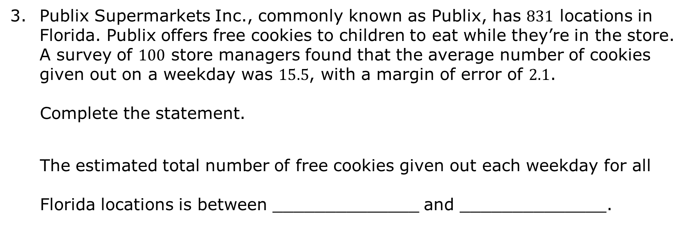
Publix Supermarkets Inc., commonly known as Publix, has $831$ locations in Florida. Publix offers free cookies to children to eat while they’re in the store. A survey of $100$ store managers found that the average number of cookies given out on a weekday was $15.5$, with a margin of error of $2.1$.
Complete the statement.
The estimated total number of free cookies given out each weekday for all Florida locations is between ______________ and ______________.
volume 2, pg. 229

Slide 22

Wrap-Up
volume 2, pg. 229

Slide 23
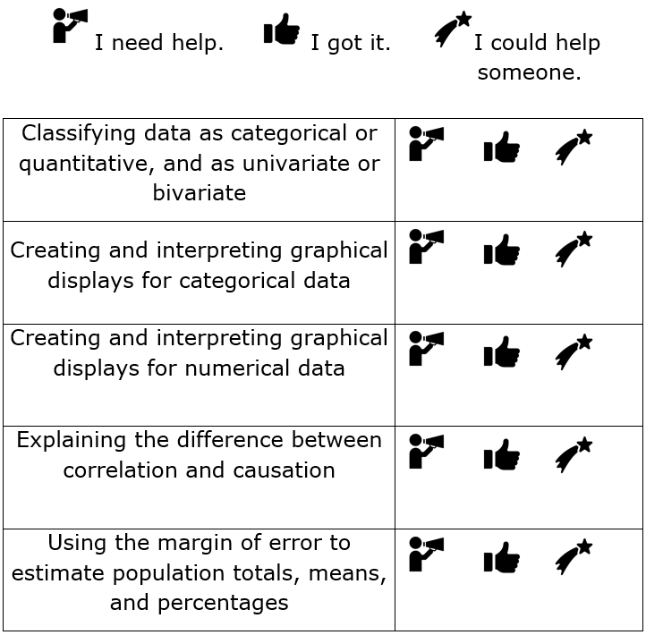
12.6.5 Wrap-Up: Reflection
Circle the icon that best describes your understanding of each.
volume 2, pg. 229

